Slide 1
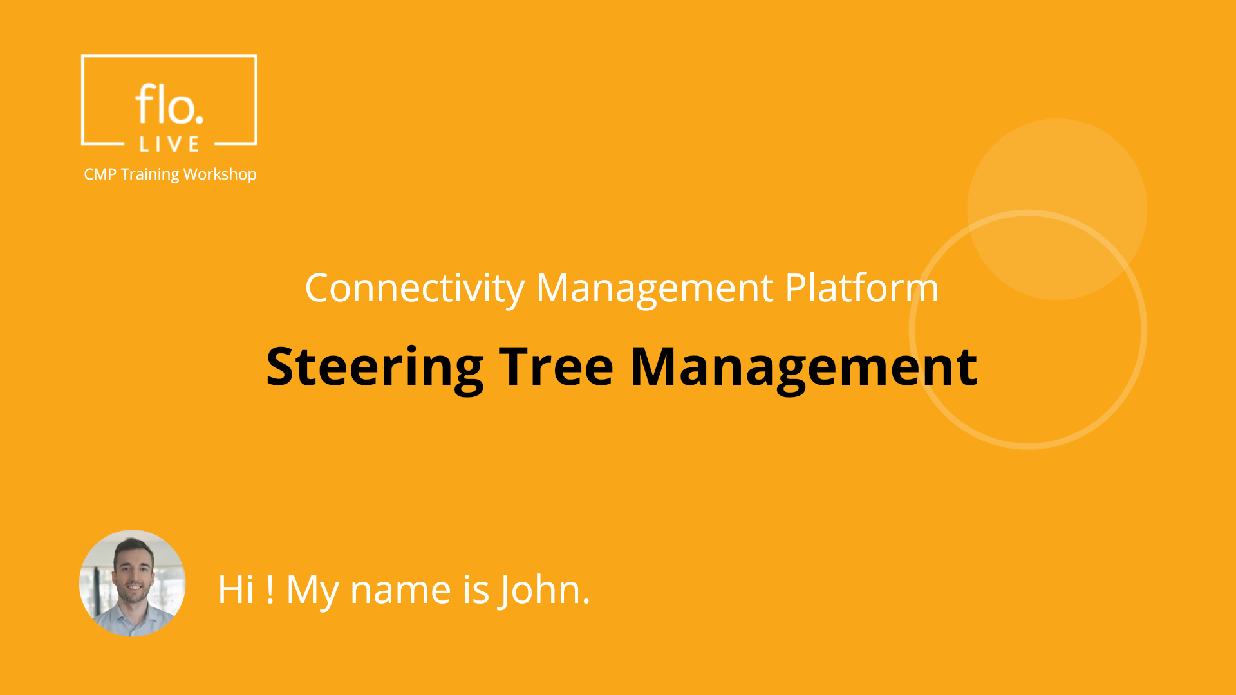
Notes:
Hi, My name is John and welcome to the CMP Training Workshop

Slide 2
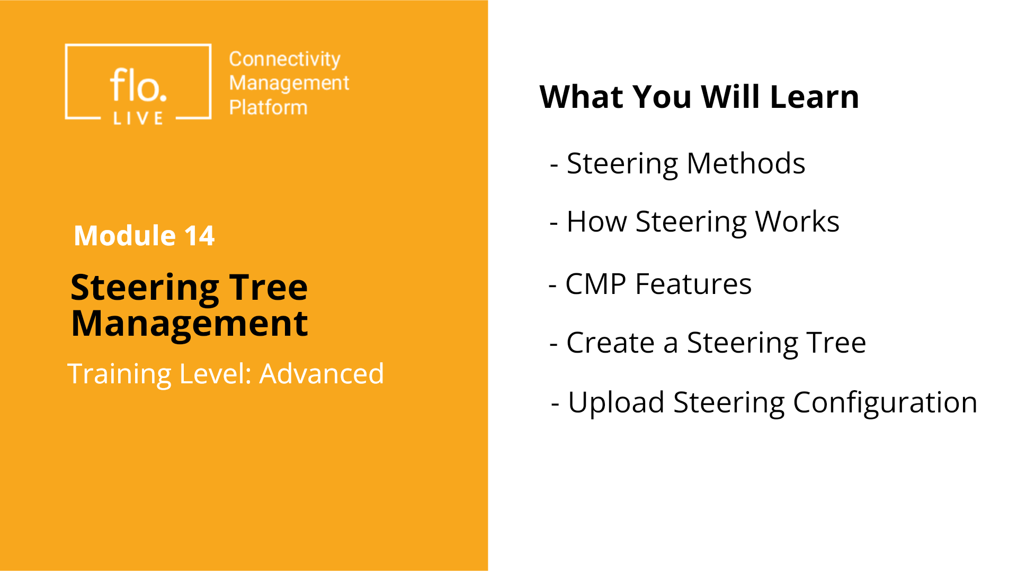
Notes:
In this tutorial we explore the concept of Steering Tree Management. We'll begin by learning about key steering methods, and then describe how the CMP steering mechanism works. . We will also go through the steps of creating a new Steering Tree, , and learn how to upload steering data to the CMP Portal via a csv configuration file Let’s dive in!

Slide 3
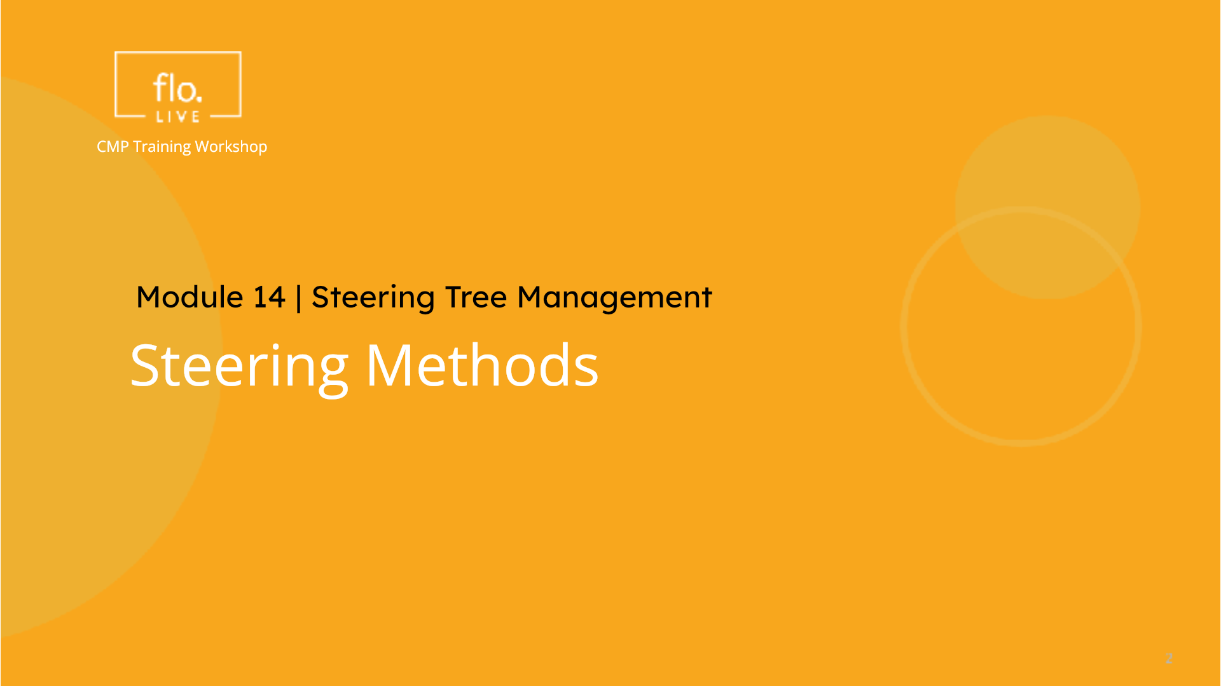
Notes:
We begin this tutorial by exploring what Steering means and about the different types of Steering methods.

Slide 4
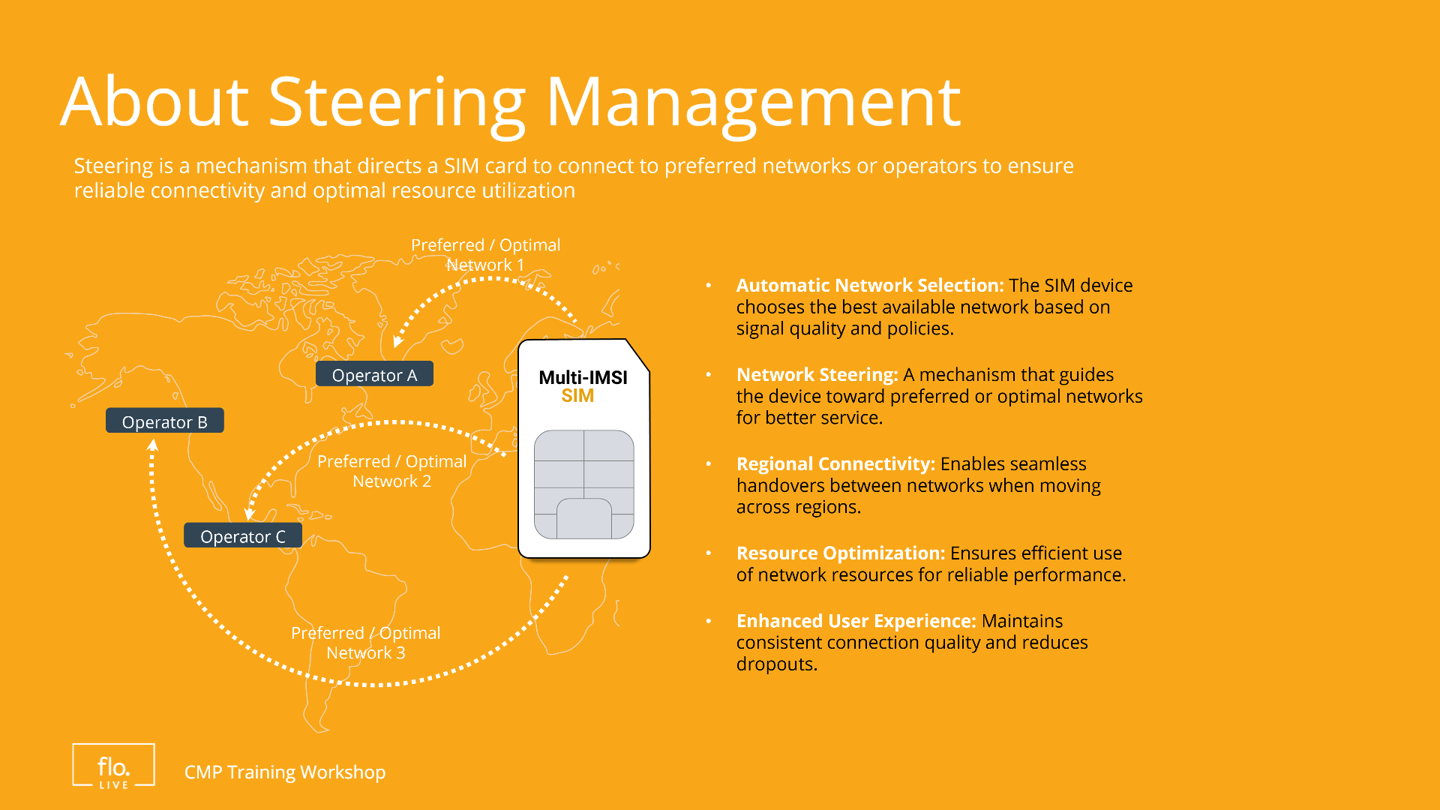
Notes:
Steering, refers to how SIM-based IOT devices, connect to a network. The Steering mechanism directs a SIM card to connect to preferred networks to ensure reliable connectivity, and optimal resource utilization. In this context, a Steering Tree defines which networks are allowed and which are blocked for a given IoT device.

Slide 5
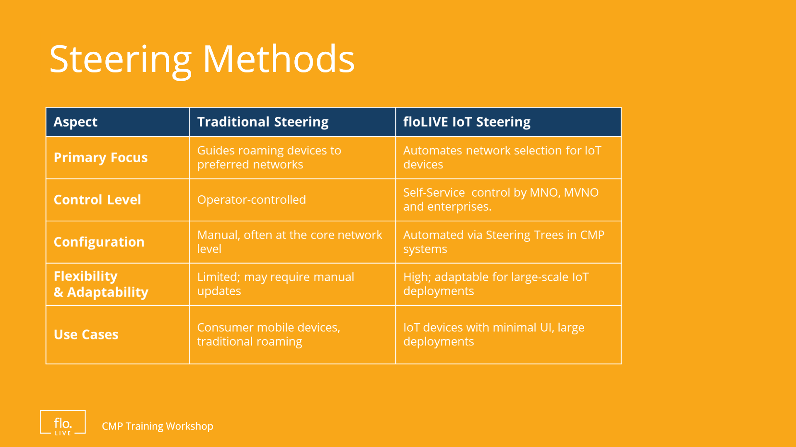
Notes:
Take a look at this table! It compares two different steering methods: Traditional Steering, and floLIVE IOT Steering Management. Traditional Steering focuses on guiding mobile devices to preferred networks and is usually operator-controlled with manual configuration. In contrast, IoT Steering Management, automates network selection for IoT devices using predefined rules and steering trees. This self-service method offers high adaptability for large-scale IOT deployments. In summary, this table highlights the shift from traditional complex and manual network control to a fully automated, IoT-centric steering management solution.

Slide 6
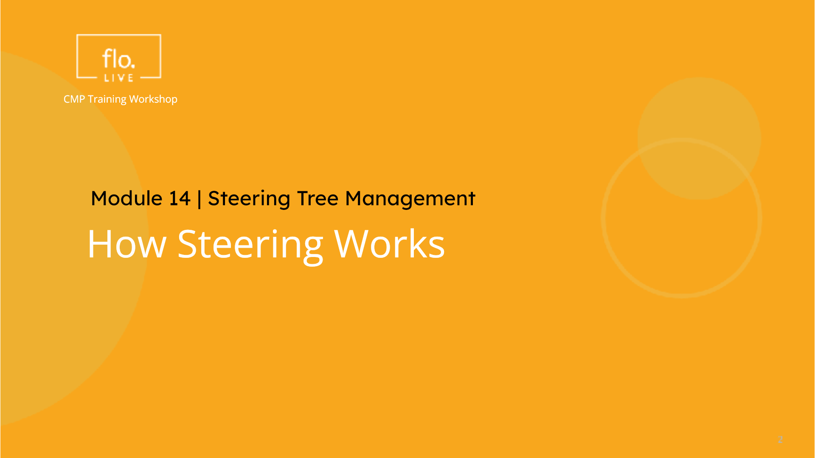
Notes:
Now lets take a quick look at how Steering Management works for different operators and networks.

Slide 7
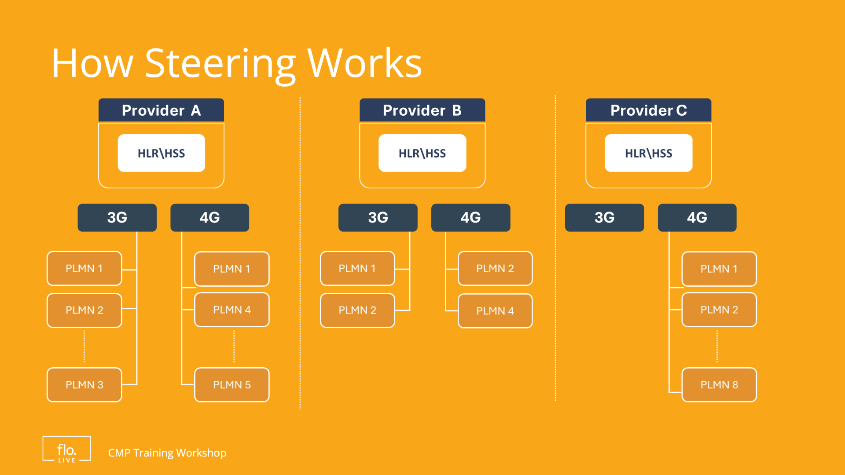
Notes:
This diagram, shows how different IMSI providers connect to different networks based on the configuration in the HLR/HSS component. As you can see, Provider A, B and C deliver connectivity via different country Operators referred to as PLMNs) It is important to remember that Steering trees are defined per IMSI provider, and can be configured differently for 3G or 4G networks. This method ensures that IoT devices can connect seamlessly and reliably by automatic selection of the best available network, (allowed by the IMSI provider). Automating this process through steering trees, reduces manual intervention and enables optimized device connectivity for large-scale IoT deployments.

Slide 8
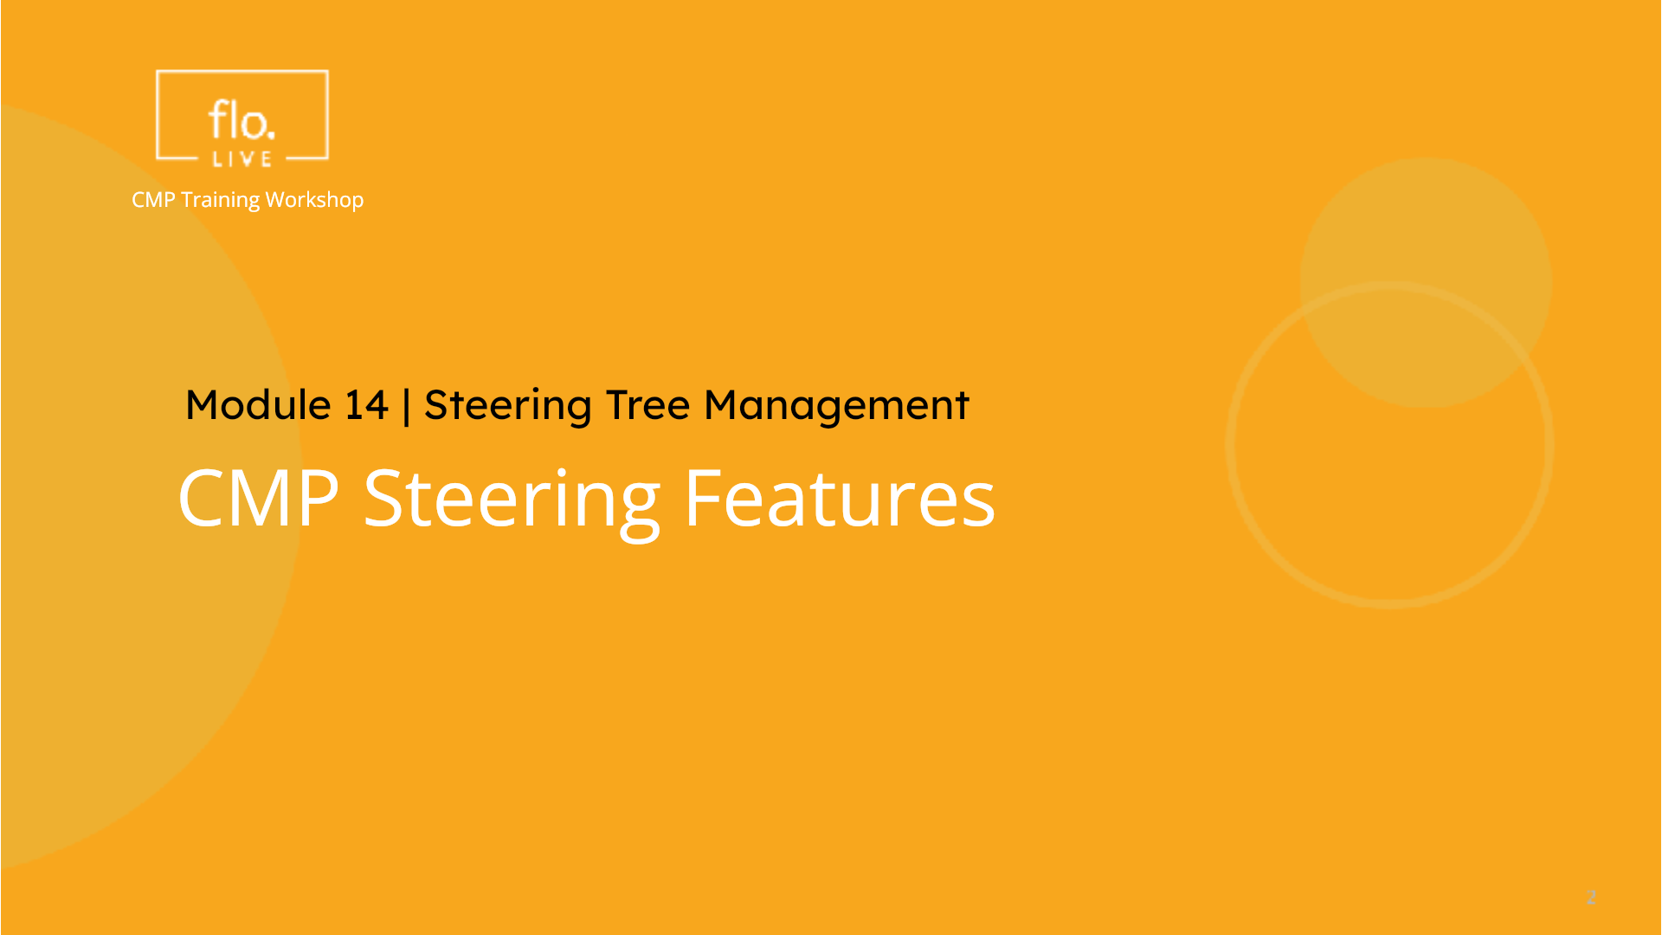
Notes:
Lets take a look at how we manage steering in the CMP portal.

Slide 9
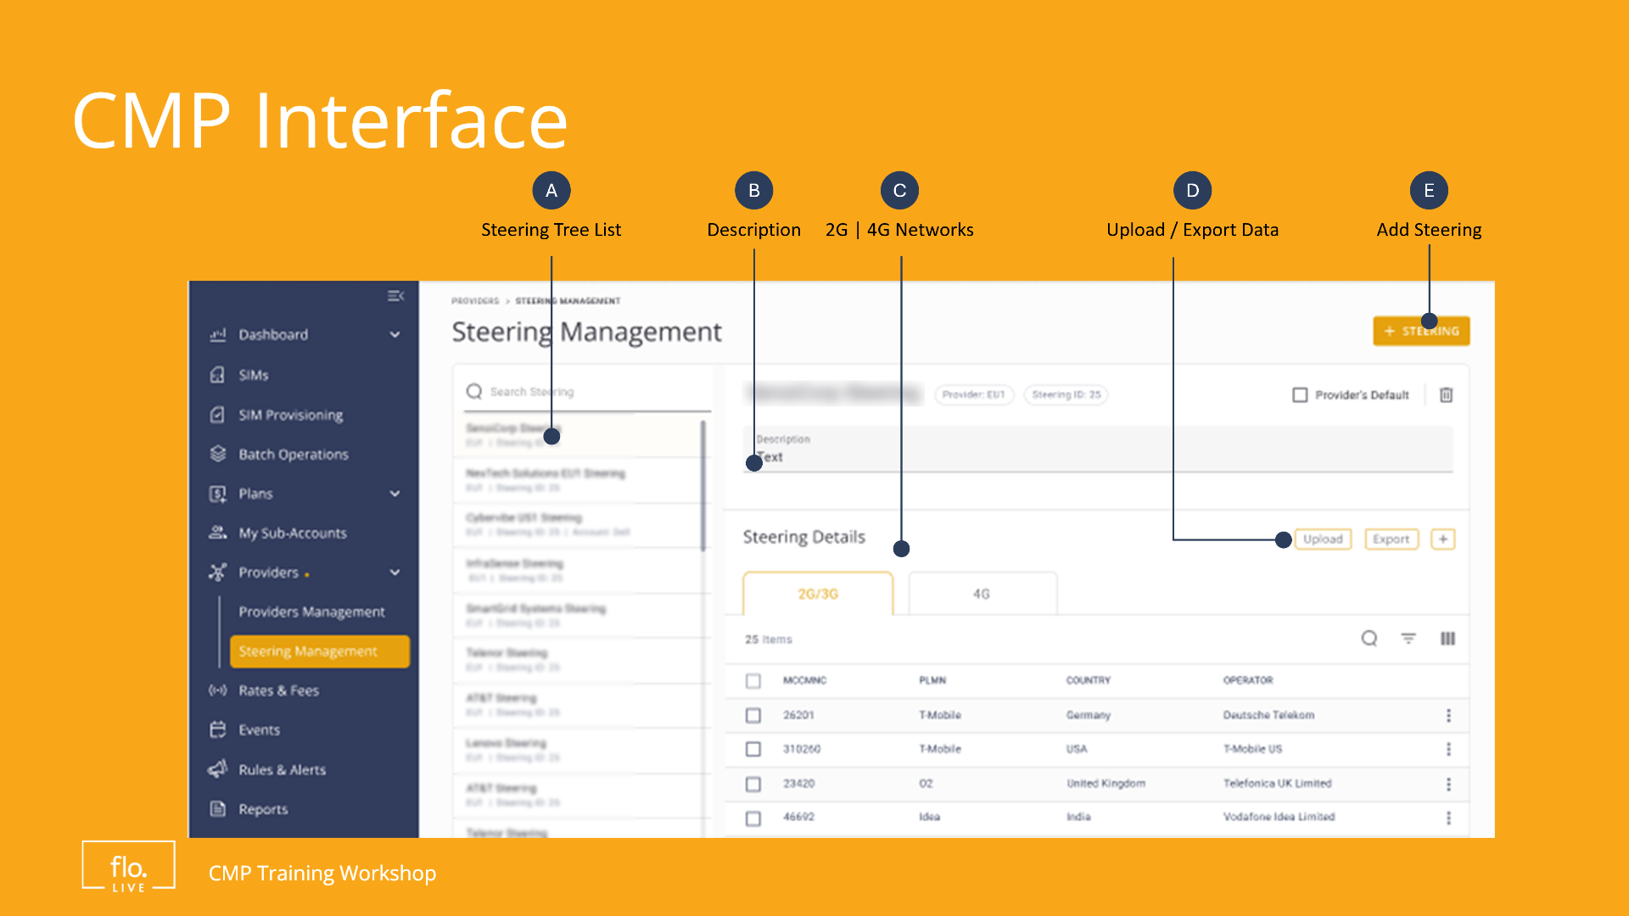
Notes:
Steering trees are set up in the Provider Management module. In this module, you can create, view, and manage your steering configurations. When you access this page, you can see a list of existing steering trees, with descriptions and IMSI provider details. You can easily add new steering trees, upload or export steering data, and adjust the rules for 2G, 3G, and 4G networks. Customers can create multiple trees for different use cases, different device models and commercial agreements.

Slide 10
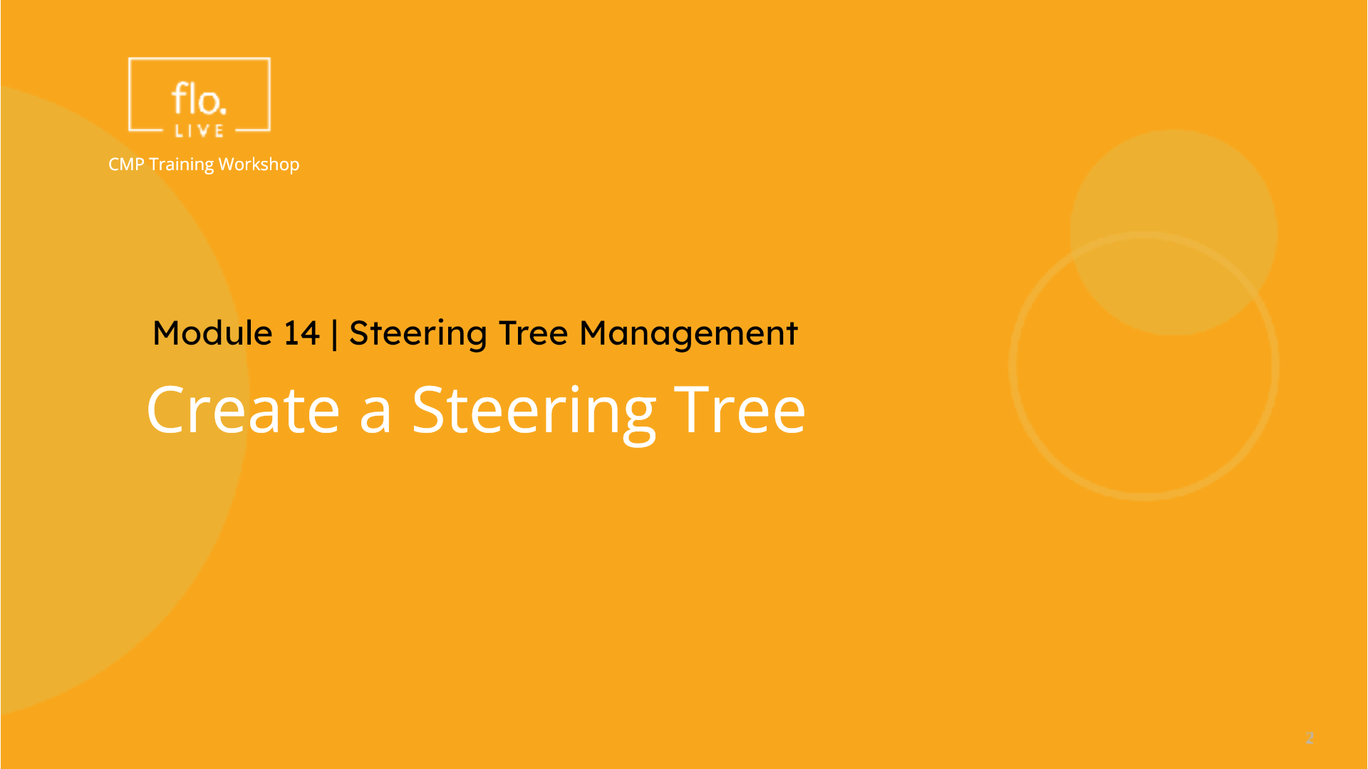
Notes:
Now that we understand how Steering management works, lets create a new steering tree in the CMP portal.

Slide 11
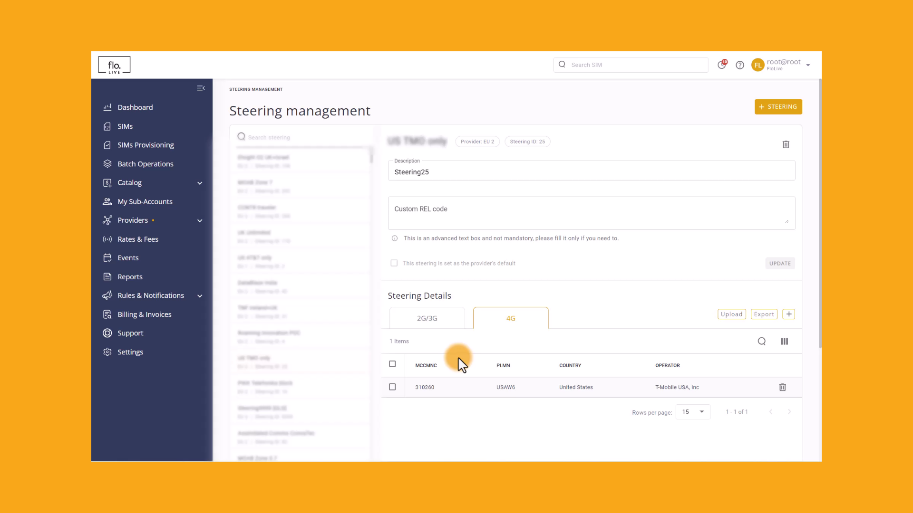
Notes:
To display the Steering page, navigate to the Providers module in the sidebar and select the 'Steering Management' option. . The left side of the page shows a list of existing steering configurations. You can view the steering details on the right side of the page. Scroll down to view the available 3G and 4G configurations. Now, let's create a new steering tree. Click on the Plus Steering' button to get started. The settings dialog box enables you to enter all the parameters required to create a steering tree. . Enter a name for the new Steering tree. Next, select a Provider listed in the drop-down field. Now you need to select one or more Accounts. Finally click Create' to begin processing the steering tree . When the new steering tree entity is created, it is displayed in the list in the left panel. . Now you need to coonfigure the Steering tree by uploading the applicable PLMN data.

Slide 12
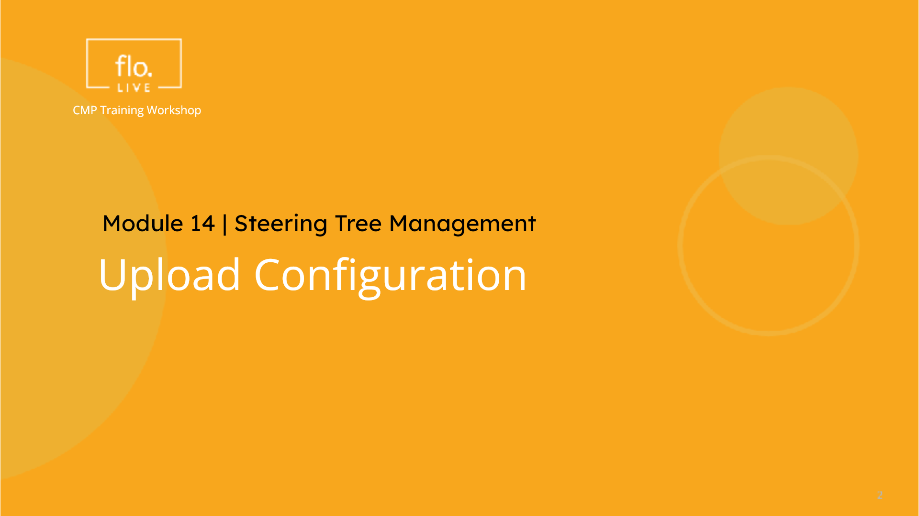
Notes:
When you create a new Steering Tree Entity, you need to upload the list of PLMN (operators) via a CSV file. To simplify this process, you can use the Upload Configuration feature. This feature enables you to quickly apply predefined network settings to your steering tree. Let's see how to do it.

Slide 13
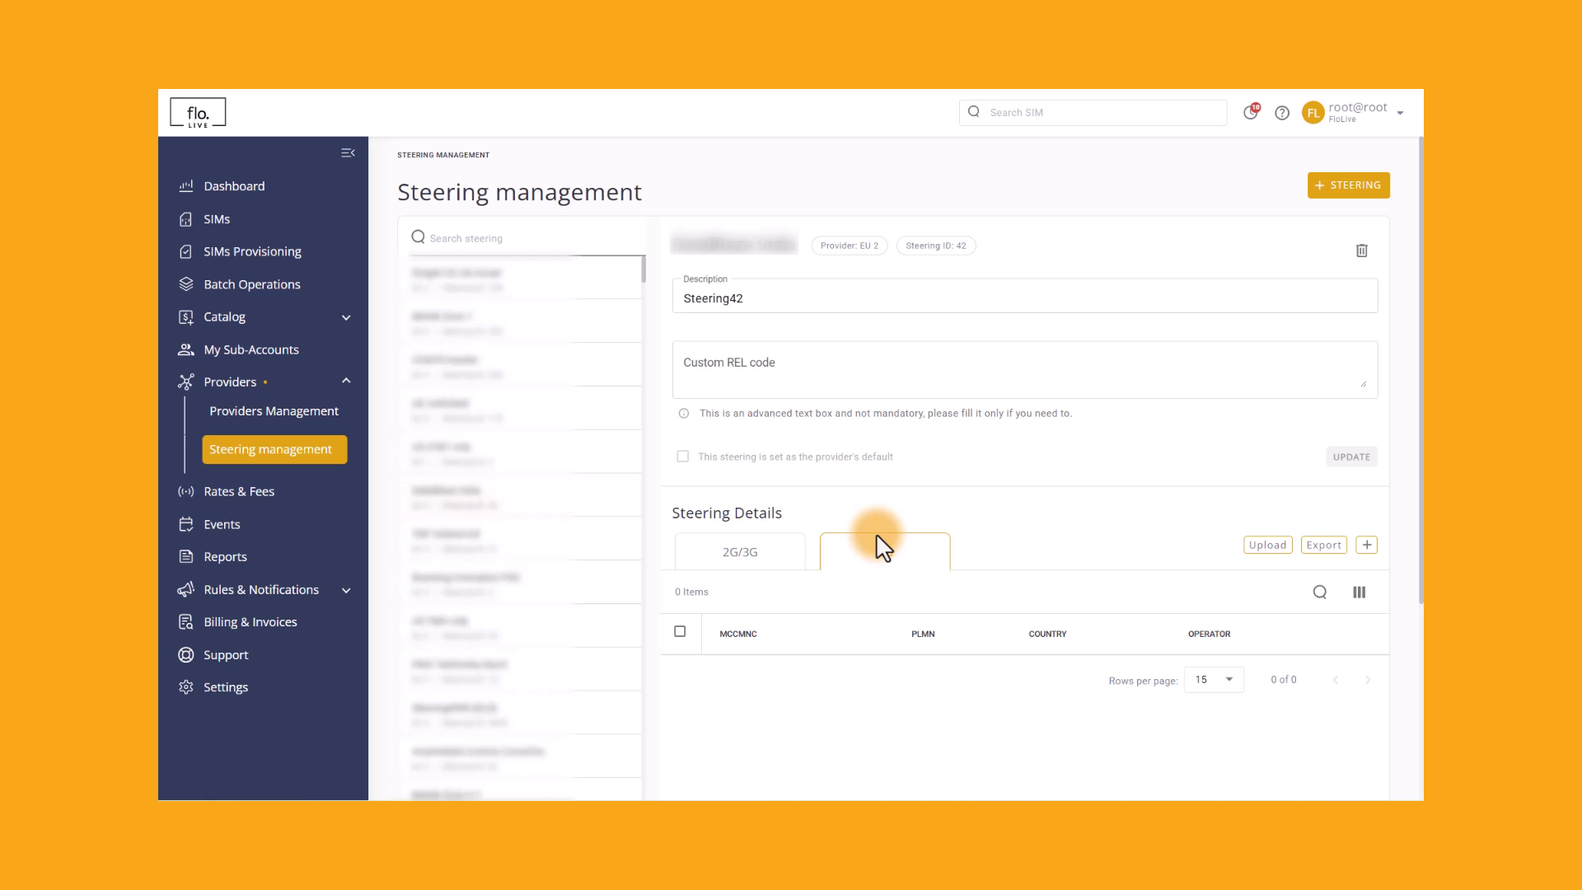
Notes:
Go to the Steering Details section, and click the 'Upload' button." Now select either 2G,3G or 4G networks, based on your device connectivity requirements." Select "New Update" for the Upload Mode. Now click 'Upload from your PC' and select the csv or Excel. When the "Success Message is displayed, click the Upload button to update the CMP portal with your predefined configurations. Thats it, you're done!

Slide 14
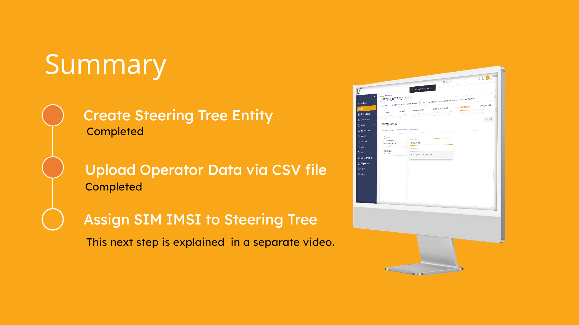
Notes:
In this tutorial we learnt how to create a Steering Tree Entity and upload operator data via a CSV file. Now you are ready to assign one or more SIM IMSIs to the Steering trees. This task is explained in a separate video tutorial.

Slide 15
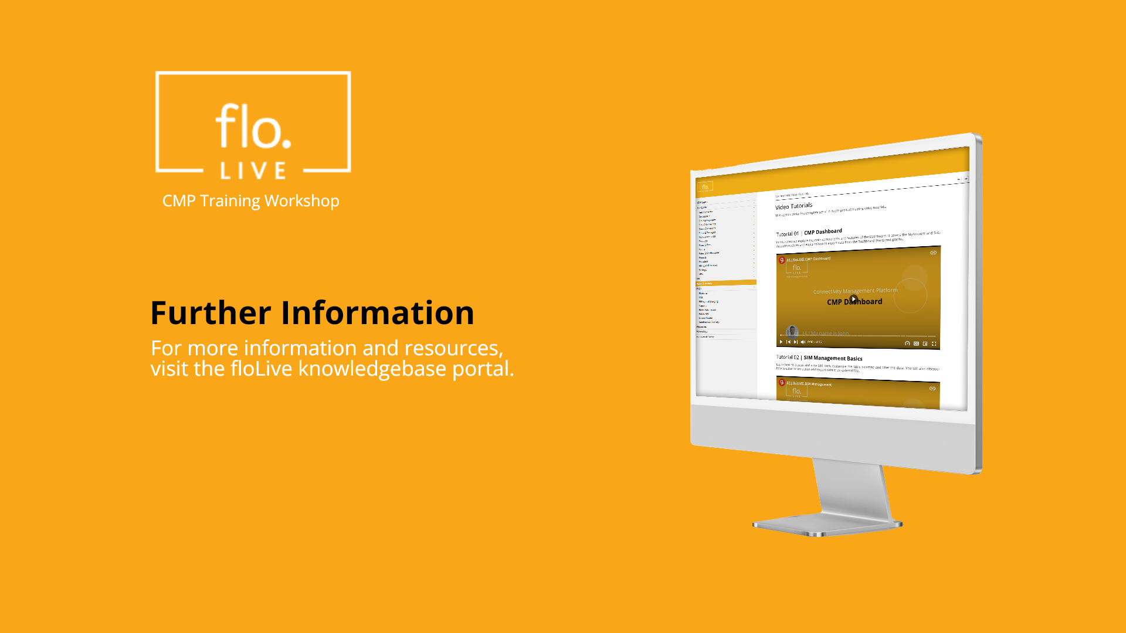
Notes:
Thank you for watching this video tutorial. For more information about the CMP system, make sure you visit our Knowledge-base that is accessible directly from the CMP Portal.

